Slide 1
EDUC2323 Computer Programming as a Tool for Learning
Syntonic and unplugged learning

Slide 2
Some pointers on theory and research in your blogs
Ask yourself: why do you think that engaging with your topic via a computer program would be helpful or effective for learners?
  Why don’t we just sit your ‘learner’ down and talk at them until they understand your topic?
  What does the interaction with the computer/program offer?
Let’s recap some of the theoretical concepts we have discussed and read so far:
  Workshop 1 & 2: Meaningful learning, Constructionism, Computational thinking
  Workshop 3: Just in Time Learning (JITL)
  Workshop 4: Microworlds for learning
But! Don’t forget that most of these ideas are based on existing, general theories of learning due to people like Piaget, Vygotsky, Bandura and Bruner. You can use these theorists’ ideas too!
Also Games Based Learning theory might be useful - see chapter 4 of Teaching with technologies: the essential guide (Younie, Leask 2013)

Slide 3
Some other pointers on theory and research in your blogs (2)
And… Don’t forget to check for relevant sources within research and professional literature
For research literature:
  Check Education Research Complete and the library catalogue
  Check Google Scholar
And remember that we have explored examples of:
  Teacher and researcher blogs
  Action research
  Professional magazine article
All these kinds of sources are appropriate to cite in this task, as long as you evaluate accuracy, relevance, date etc.

Slide 4
LoFi algorithm example
How do you sort a list of 10 numbers?
Bubble sort (one of the first algorithms I learnt)
A bit old fashioned now but still makes the point!
Mix up ten numbers
Lay them out as a list in front of you
Start at the top of the list and compare the first two numbers
Swap the numbers only if the first number is higher than the second number
Now go to the next number
Repeat step 4 until the list is sorted

Slide 5
Remember back to workshop 1?

Slide 6
‘Unplugged’ Computer Science…
It is possible to engage in computational thinking whilst not actually working at a computer.
Making links between programming concepts and the ‘real’, physical, practical world can really help some people learn.
Motivation for Tim Bell et al’s ‘Computer Science Unplugged’ free book (2015).
Build’s on Seymour Papert’s (1980) theoretical idea of ‘syntonicity’

Slide 7
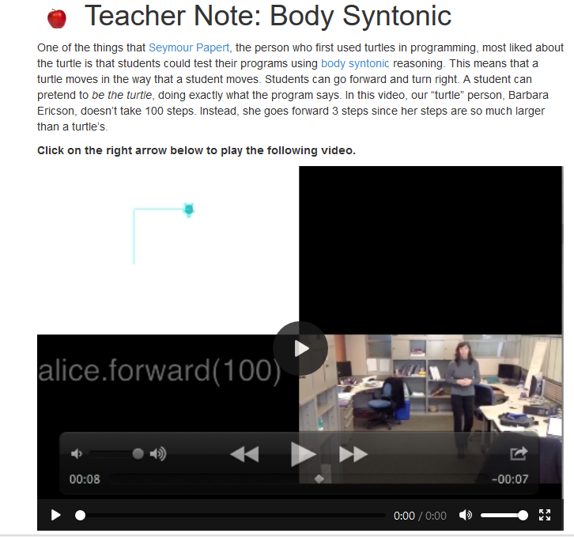
Syntonicity
http://ice-web.cc.gatech.edu/ce21/1/static/Teacher-CSP/CSPNameTurtles/bodySyntonic.html

Slide 8
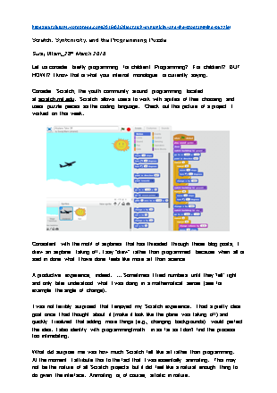
Reading: Blog Post by Uttam (2016)
What other types of syntonicity can you identify?
According to the blog author, how does Scratch extend or challenge the ideas of syntonicity that were associated by the older educational programming language Logo?

Slide 9
Types of Syntonicity
Computers and programming can be very abstract and mathematical
Doing something in the “real world” that we do in the computer
  Body – physical self
  Ego – experience and feelings, relevant to self
  Cultural – values, social, cultural

Slide 10
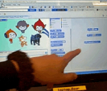

Example from action research (Briggs, 2013)
Case studies of Year 6 pupils using Scratch in 3 primary schools by Julia Briggs, Primary Education Technology Advisor, Somerset County Council.
“A pair of girls discovered ways to move and turn their character around the screen. Their enjoyment was clear and also their willingness to ‘have a go’ to see what might happen.” (p3)
“A pair of boys became fascinated by the movements they caused, ‘He’s circling, he’s going sideways because he’s a crab.’” (p3)
“Papert’s (1984) description of the turtle in logo programming, as being body syntonic, was echoed by the children who explored the use of programming blocks to create movements for sprites.”
“[… The] pair of girls giggled as their actions caused the character to turn or move off the stage. [The] pair of boys was proud of their crab which moved sideways round a circle.” (p9)

Slide 11
Think about how far we have come…
Programming concepts and Scratch blocks etc
  Motion: move, turn, point in direction, set y to, change y by
  Looks: say [for x secs],
  Sound: play sound
  Pen: clear, pen down, set pen colour to
  Variables: set X to N, change X by, show/hide
  Events: when green flag pressed ,when X key pressed
  Control: wait, repeat, forever, if/then/else, repeat until, stop all
  Sensing: touching colour, ask/answer
  Operators: maths operators, pick random, greater/lesser than, equal to
  Sprite design

Slide 12
There is more…
Some of the key remaining programming topics that will support your practical work:
  More sophisticated sprite animation and graphics
  Costume and backdrop changes
  More sophisticated sound/music operations
  Lists (variables with more than one ‘memory slot’)
  Broadcasting and sprite communication
  Sprite cloning
  More advanced sensing and interaction
  Boolean logic tests (and, or, not)
  ‘Strings’ (variables for text) and string manipulation
  Maths functions and sorting
But… you now know enough to find out about these on your own, if your practical work demands it
Remember all the lovely Scratch (e)books we have in the library – all listed on in the handbook
And don’t forget you can always come and ask me (or email)

